Slide 1
A Sensitivity continuum for mystical and spiritual experience
7th Exploring the Extraordinary Conference
York December 2015
Terence Palmer PhD

Slide 2
Connecting the Probes
The unfortunate consequence of such speciality barriers is that knowledge, instead of being pursued in depth and integrated in breadth, is pursued in depth in isolation. Rather than getting a continuous and coherent picture, we are getting fragments – remarkably detailed but isolated patterns. We are drilling holes in the wall of mystery that we call nature and reality on many locations, and we carry out delicate analyses on each of the sites. But it is only now that we are beginning to realise the need for connecting the probes with one another and gaining some coherent insight into what is there (Laszlo, 1996).

Slide 3
Some Fundamental Facts
Approximately 220,000 people in England and Wales have a diagnosis of schizophrenia. In 2007 it accounted for approximately 30% of the total expenditure on adult mental health and social care services (RCP, 2012)
In the UK 5.7 million prescriptions for anti-psychotic medications were written in 2005 at a cost of £210.9 million. A further 163,600 long-acting anti-psychotic injections were prescribed, costing £5.2 million (MHF 2007)
Globally the value of psychotropic drugs alone topped $40 billion in 2008 (Bragdon, 2012)

Slide 4
Frederic W.H. Myers 1843-1901
In my view each man is essentially a spirit, controlling an organism which is itself a complex of lower and smaller selves. As you get into the profounder part of Man’s being, you get nearer to the source of his human vitality.

Slide 5
What Proportion of Health Problems are Attributed to Spirit Influence?
Psychiatrist S. Modi recorded 92% (Modi, 2000)
92 of 100 of Modi’s patients were found to have earthbound spirits attached to them, 80 patients had more than one, 50 patients had spirits of relatives and 77 patients had spirits that were described by Modi as “demonic” (ibid, p. 7). Modi’s analysis also revealed that 80% of primary (acute) symptoms such as depression, anxiety, panic attacks and psychotic symptoms, and 30% of secondary (chronic) symptoms such as arthritis, sinusitis, back pain and headaches are caused by spirits, while 20% of primary symptoms and 70% of secondary symptoms were caused by past-life traumas.
According to Edith Fiore; 75% of her total case load (Fiore, 1987).

Slide 6
Vulnerability Model Components
Scharfetter’s ego fragmentation scale
Reaction to fear stimulus
Bentall’s challenge of the Kraepelinian diagnostic system
Claridge’s schizotypal scale – triggered by trauma
Thalbourne’s transliminality- predisposition to enter trance
Heap et al – hypnotisability scales
Positive and negative dimensions –energy frequencies

Slide 7
Sharfetter’s Ego Fragmentation

Slide 8
Fear Reaction Continuum
Fear
Anxiety
Panic Attacks
Phobias & Neuroses
BPD
DID & MPD
Psychosis

Slide 9
Normal Distribution Scales
Scharfetter
Fear
Bentall & Claridge
Thalbourne
Heap et al
Where do positive and negative dimensions fit?

Slide 10
Positive & Negative Dimensions
Pierre Janet’s dissociation theory asserts that all who experienced dissociation and psychic phenomena were mentally ill.
William James and Frederic Myers agreed with Janet’s dissociation theory, but disagreed with his assumption that all dissociation is pathological, but each case should be considered by its positive or negative impact, i.e. mediumship.

Slide 11
Positive & Negative Dimensions
In a study to compare twenty four Brazilian Spiritist mediums with North American dissociative identity disorder (DID) patients, Moreira-Almeida et al (2008) found that in comparison with DID patients the mediums differed in having better social adjustment, lower prevalence of mental disorders, lower use of mental health services, no use of antipsychotics, and lower prevalence of histories of physical or childhood sexual abuse, sleepwalking, secondary features of DID, and symptoms of borderline personality. Thus, mediumship differed from DID in having better mental health and social adjustment, and a different clinical profile.
Similarly, Kua et al (1986) analysed 36 young men with possession-trance syndrome. At follow-up four to five years later, none of the 26 who could be contacted showed any evidence of mental illness.

Slide 12
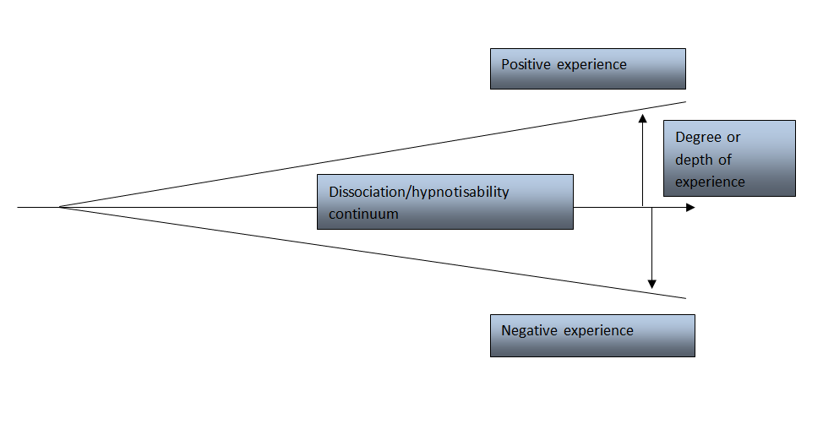
Vulnerability Model

Slide 13
The Continuum of Spiritual Experience
All human experiences exist on a continuum in the evolution of consciousness.
Nothing is ‘super’ natural, all is natural.
Nothing is ‘para’ normal, all is normal.

Slide 14
Recent Research
In their systematic review of papers indexed on the Medline database on complementary Spiritist therapy, Lucchetti et al (2011) conducted a meta-analysis of Spiritist methods of healing which included dis-obsession (Spirit Release Therapy). Of the 49 studies found that were concerned with dis-obsession, none were included in the meta-analysis due to methodological problems in their design and their inconclusive results.

Slide 15
Research Conferences

Slide 16
Research Proposals
Efficacy of clairvoyant / telepathic diagnosis
Adjunctive treatments for chronic psychological conditions such as:
Domestic violence & sexual abuse
Paedophilia
Tourette’s syndrome
DID and Schizophrenia
Command hallucinations
Addictions

Slide 17
Final Question
Who will accept the challenge?

Slide 18
A Scientific framework to accommodate all spiritual phenomena

Slide 19
Thank you for listening
Any questions?
References
Bragdon, E. (2012) Spiritism and Mental Health. London: Jessica Kingsley Publishers
Fiore, E. (1987) The Unquiet Dead. New York: Ballantine Books
Mental Health Foundation (2007) Fundamental Facts. London: Mental Health Foundation
Modi, S. (2000) Remarkable Healings. Charlottesville: Hampton Roads Publishing
Moreira-Almeida & Santos (2012) Exploring Frontiers of the Mind-Brain Relationship
Myers, F. (1903) Humen Personality and its Survival of Bodily Death. New York: Longmans, Green & Co
Palmer, T. (2015) The Science of Spirit Possession - 2nd edition. Newcastle-upon-Tyne: Cambridge Scholars Publishing
Royal College of Psychiatrists (2012). Report of the National Audit of Schizophrenia (NAS) London: Healthcare Quality Improvement Partnership.
www.tjpalmer.org
palmert55@gmail.com

