Slide 1
Evil, Mad or Possessed?
Seriously Strange Conference 2016
Reading
Terence Palmer PhD

Slide 2
A Method for Investigation
A scientific research protocol with a method of investigating auditory hallucinations that were acted upon by serious criminals was originally presented at a conference held at Bangor University in 2008.
The hypothesis is that there is a difference between auditory hallucinations and veridical voices that originate from an external source.
A more detailed scientific project protocol is contained in the final chapter of The Science of Spirit Possession (2nd edition) (2014).
In order to test the hypothesis, remote spirit release practitioner teams are currently being evaluated for their reliability and a pilot experiment is in progress to test their efficacy in treating subjects who hear voices. Video recordings of sample cases on You Tube can be accessed only by invitation to bona-fide researchers and students for educational purposes. These cases are confidential and not yet available for public viewing. Two such cases are specific to this hypothesis, one of which is presented here at this conference in a few moments.

Slide 3
Prospective sample groups
Voice hearers. People who are troubled by voices that cause distress
Schizophrenics. Those who have been diagnosed with schizophrenia and auditory hallucinations and have been confined under the mental health act
Serial rapists who have been imprisoned and who claim to hear voices
Paedophiles who claim to hear voices
Spontaneous mass killers who have been imprisoned for mass murder and who claim to be motivated by command hallucinations
The incidence of mass killings in the USA

Slide 4
Mass Killers Who Hear Voices and Act Upon Them
What proportion of mass killers hear command hallucinations?
Are these perpetrators evil people?
Are they mentally ill and not responsible for their actions?
Are they ‘possessed’ or influenced by an external source that is veridical and identifiable?
How can scientific research answer these questions?

Slide 5
How to Research Killers Who Hear Command Hallucinations – Method 1
Dr Helen Morrison
Forensic Psychiatry

Slide 6
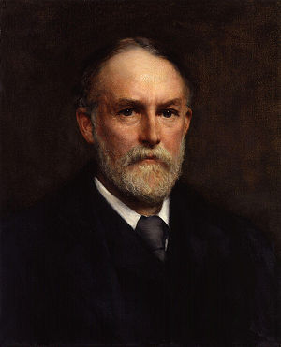
How to Research Killers Who Hear Command Hallucinations – Method 2
Frederic Myers
Access the subliminal mind

Slide 7
The Case of Jason Dalton
On the night of February 20, 2016, six people were killed and two others injured in a series of apparently random shootings that took place at an apartment complex, outside a restaurant, and a car dealership in Kalamazoo County, Michigan. Police detained a 45-year-old taxi driver, Jason Brian Dalton, as a strong suspect in the shootings, who was subsequently charged with the crime.
After his arrest, Dalton confessed to committing the alleged offence. However, he blamed his actions on his Uber mobile app, claiming that its symbol resembled that of the Order of the Eastern Star, and that it took over his body during the events after he pressed the button of a new app resembling the devil when it abruptly popped up. Police indicated that he had no known criminal history or mental health record.

Slide 8
A Remote Spirit Release Investigation
A soul rescue and spirit release group of seven participants sat in a remote location from the accused with the intention of investigating, by trance-induced remote viewing methods, the spirit influence, if any, that may have contributed to the perpetrator’s actions.
The investigation took place as the accused man waited in jail for his trial.
The following video recording focusses on the two key members of the circle, the facilitator and the principal medium (scanner) who uses his clairvoyant abilities in a form of astral projection, to scan the subject at and from a distance.
The shadowing discarnate entity is invited to speak to the facilitator through the medium, who, in some cases, may permit himself to become temporarily possessed by the spirit entity in order to facilitate dialogue.
Here is an example:

Slide 9
Can spirits incite serious crimes?

Slide 10
Questions raised
Is this the result of the scanner’s overactive imagination?
How can we distinguish the difference between imagination and veridical authenticity?
Can the scientific research into ‘remote viewing’ add credence to the method?
Can the scientific evidence for astral projection, bi-location, clairvoyance and telepathy add credibility to the phenomenon?

Slide 11
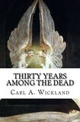
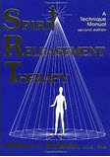
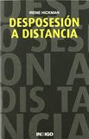
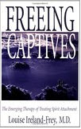
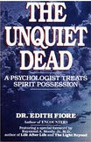
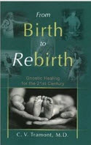
A Selection of healthcare professionals who have documented their successful application of SRT in Clinical practice
Notes:
Although much has been written on the efficacy of these methods in case studies by these clinicians, they have never been subjected to examination under strictly controlled conditions.

Slide 12
Questions to be addressed
What could be the benefits and objections to a research project to test the hypothesis that spirits do incite people to commit serious crimes against other humans?
Under what experimental conditions could the remote spirit release method be scientifically validated?
Would it be possible to interview perpetrators who hear voices whilst imprisoned?
Which scientific institution would be willing to test the hypothesis?
Who would fund such an experiment?

Slide 13
SRT Research Proposals
Access the original paper via the website here.
A detailed research protocol is in chapter 15 of this book. Click on the book cover image for direct access to the publisher to order online. Use the 20% discount code Spirit20.
Scientific institutions are invited to access these materials and consider the practicality of putting them into effect.
Email me at: palmert55@gmail.com

Slide 14
Thank you for listening
Any pragmatic suggestions?

