Slide 1

Telepathic hypnosis
The neglected concept
38th SPR Annual Conference
York University. 5-7th September 2014
Terence Palmer PhD

Slide 2
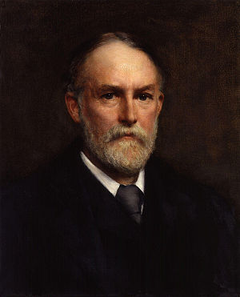
Frederic W.H. Myers 1843-1901
My discussion, I may say at once, will avoid metaphysics as carefully as it will avoid theology. For somewhat similar reasons I do not desire to introduce the philosophical opinions which have been held by various thinkers in the past, nor myself to speculate on matters lying beyond the possible field of objective proof .

Slide 3
Plan of the talk
The importance of telepathic hypnosis (TH) and why it has been abandoned by psychology research
Historical connections between TH & psi
Case study
Research proposals

Slide 4
The importance of telepathic hypnosis
The evidence for telepathy – for psychical influence from a distance – has grown to goodly proportions, for a new form of experiment has been found possible from which the influence of suggestion can be entirely excluded. It has now, as I shall presently try to show, been actually proved that the hypnotic trance can be induced from a distance so great, and with precautions so complete, that telepathy or some similar supernormal influence is the only efficient cause which can be conceived (Myers, 1903b, p. 140).

Slide 5
Historical connections (1)
Marquis de Puysegur (1785)
James Esdaile in India (1846)
Frederic Myers & Pierre Janet (1886)
Leonid Vasiliev and the electro-magnetic theory (1920s -1950s)

Slide 6
20th century research (1920s – 50s)
Athens to Paris – 2,101 km
Warsaw to Athens – 1,597 km
Vienna to Athens – 1,284 km
Leningrad to Sevastopol – 1,700 km
New York to Paris – 5,843 km
London to Australia – 16,983 km

Slide 7
20th Century Milestones
Thouless & Wiesner ‘psi’ (1947)
J.B Rhine & Ed Mitchell Apollo 14 (1971)
Hal Puthoff & Ingo Swann (1982)
US Department of Defense (1982 – 1995)
Russell Targ (1999)
William Braud (DMILS) (2003)
SRT & Spiritist de-possession (1930s – current)

Slide 8
Evolving research
Telepathic hypnosis – Myers & Janet
Freud’s psychoanalysis & Watson’s behaviourism
Chemical anaesthetics as an alternative to hypnosis or magnetism
Electro-magnetic theory of telepathy – Vasiliev
Psi research – J B Rhine & Noetic Institute
Remote viewing – Puthoff & Targ
Remote depossession - Almeida & Luchetti
Spirit release therapy - ?

Slide 9
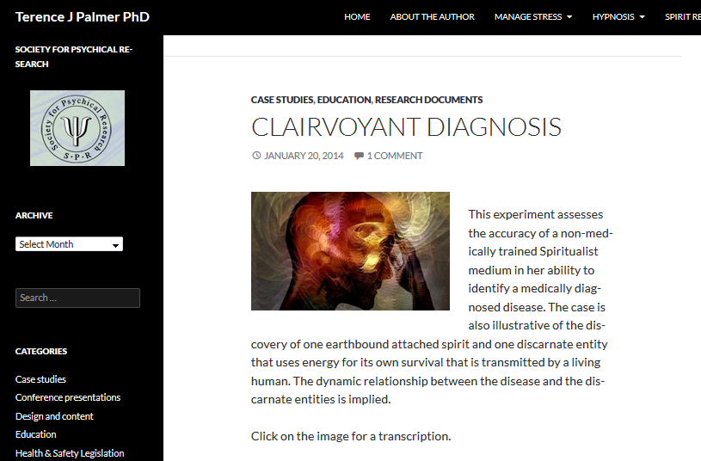
Case Studies

Slide 10
Research Proposals
Clairvoyant / telepathic diagnosis
Adjunctive treatments for chronic psychological conditions such as:
Domestic violence & sexual abuse
Paedophilia
Tourette’s syndrome
DID and Schizophrenia
Command hallucinations
Addictions

Slide 11
Final Questions
What is the unidentified experimental variable in telepathic communication?
PSI or Spirit?
Who will accept the challenge?

Slide 12
Thank you for listening
Any questions?
Essential Reading
Bragdon, E. (2012) Spiritism and Mental Health
Braud, W. (2003) Distant Mental Influence
Crabtree, A. (1993) From Mesmer to Freud
Moreira-Almeida & Santos (2012) Exploring Frontiers of the Mind-Brain Relationship
Palmer, T. (2013) The Science of Spirit Possession - 2nd edition in prep
Vasiliev, L. (1963) Experiments in Mental Suggestion
www.tjpalmer.org
palmert55@gmail.com

