Slide 1
The Art of Discernment in Spirit Release Therapy
Wild or Domesticated Interdisciplinary Conference 2016
Helsinki
Notes:
20 minutes

Slide 2
SRT Methods of Discernment
A brief overview with audio-visual examples

Slide 3
SRT – What’s it for?
Clairvoyant diagnosis & disease aetiology
Earthbound soul rescue from places
Attached spirit release from persons
De-possession from places and people
Spiritual immunity & psychic self-defence

Slide 4
SRT Methods of communication
Direct – one to one, face to face
Indirect – Remote, from a distance
Group indirect - remote group from a distance

Slide 5
Methods of discernment
Direct intuitive (Mediumistic therapist)
Direct interactive (Mediumistic client)
Direct positive possession (Possessed client)
Remote viewing (Clairvoyant scanner)
Remote interactive (Mediumistic scanner)
Remote positive possession (Possessed scanner)
Group remote method (Multi-intuitive, interactive and positive.

Slide 6
Classes of spirit
Discarnate consciousness of any kind (Baldwin, 1995)
Human higher-self
Spirit guide
Angels and archangels
Earthbound human
Human soul part
Human self-created thought form
Human sub-personality (DID)
Non-human dark force entity (DFE) – demonic
ET. Non-human. Interdimensional high intelligence alien
Elementals – earth, fire, water, air
Animals, fairies, elfs, goblins, etc.
Other interdimensional life forms less clearly defined

Slide 7
Direct positive method

Slide 8
Remote viewing method

Slide 9
Remote interactive method

Slide 10
Remote positive method

Slide 11
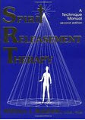
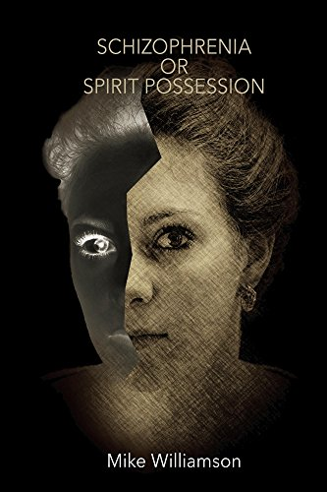
A Selection of healthcare professionals who have documented their successful application of SRT in Clinical practice
Notes:
Although much has been written on the efficacy of these methods in case studies by these clinicians, they have never been subjected to examination under strictly controlled conditions.

Slide 12
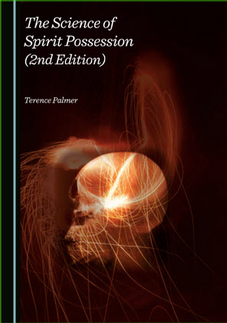
SRT Research Proposals
A detailed research protocol is in chapter 15 of this book. Click on the book cover image for direct access to the publisher to order online. Use the 20% discount code Spirit20.
Scientific institutions are invited to access these materials and consider the practicality of putting them into effect.
Email me at: palmert55@gmail.com

