Slide 1
Stress Management
Taking control of autonomic reflexes
Terence J Palmer PhD
palmert55@gmail.com

Slide 2
Stress models
Medical definition
Hooke’s law of elasticity
The physiological model
The transactional model
The neurophysiological model
Homoeostasis
Fight or flight

Slide 3
The Interactive Relationship
Internal environment
Nervous system
Endocrine system
Immune system
Beliefs & world view
Cognitive processing
Which of these can we control?
External environment
Natural enemies
External pressures
Family demands
Work demands
Health demands
Which of these can we control?

Slide 4
The Nervous System
Nervous System
Autonomic Nervous System
Sympathetic
Parasympathetic
Central Nervous System
Sensory - Motor

Slide 5
Autonomic reaction
Stimulus (threat)
SNS
Endocrine system
Reaction
Fight or flight

Slide 6
Cognitive Response
External Stimulus
SNS
Endocrine System
Cognitive Processing
Response

Slide 7
The Brain

Slide 8
Emotion activation

Slide 9
Hormonal pathways

Slide 10
Figure 1
A schematic representation of the stress response.
CRH, corticotrophin releasing hormone;
AVP, arginine vasopressin;
ACTH: adrenocorticotrophin releasing hormone,
E: epinephrine,
NE: norepinephrine.
Chiropr Osteopat. 2006; 14: 25. Published online 2006 October 18. doi: 10.1186/1746-1340-14-25.
Copyright © 2006 Hardy and Pollard; licensee BioMed Central Ltd.

Slide 11
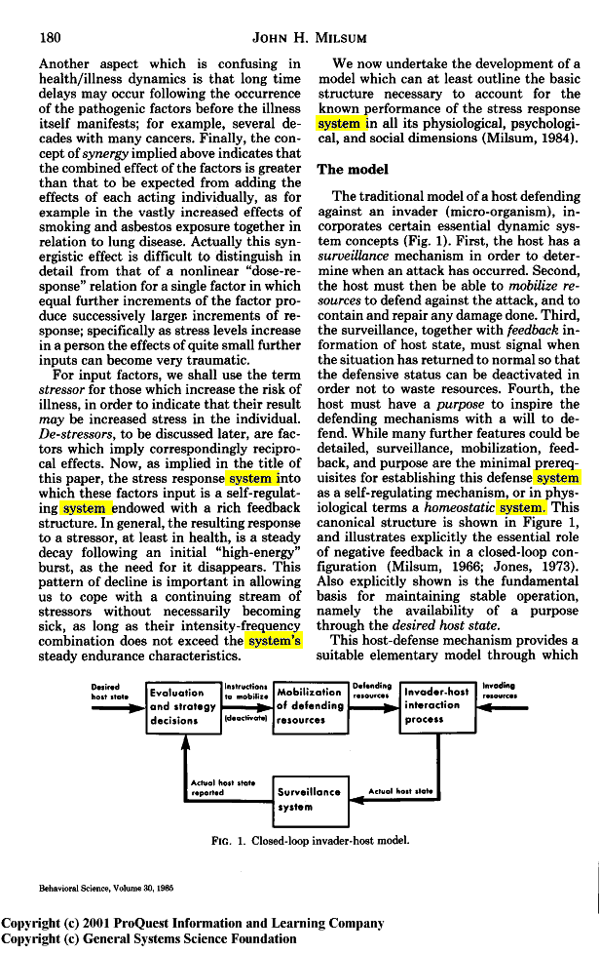

Slide 12
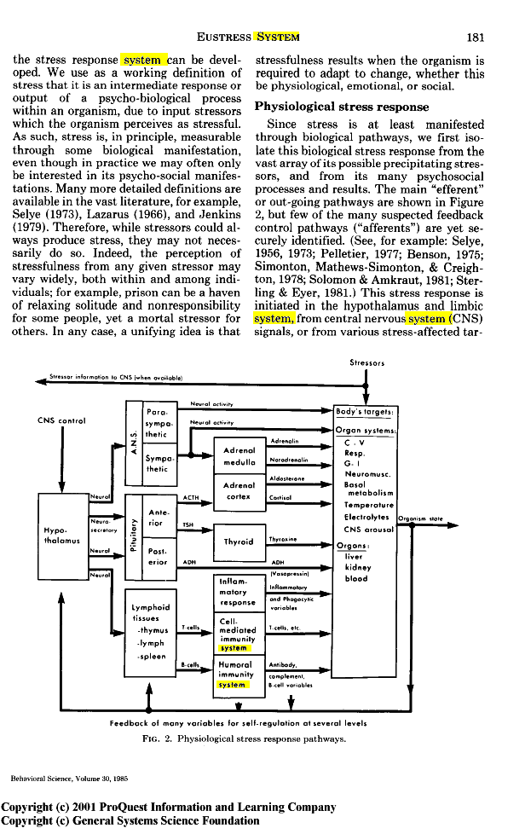

Slide 13
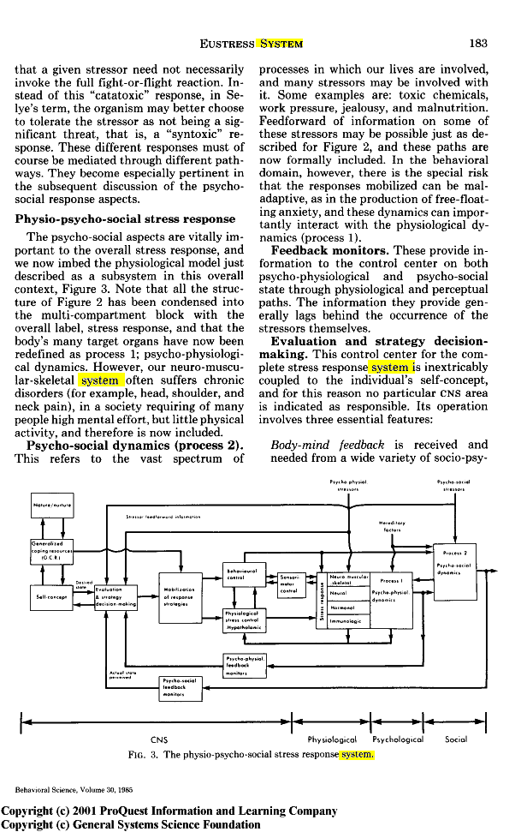

Slide 14
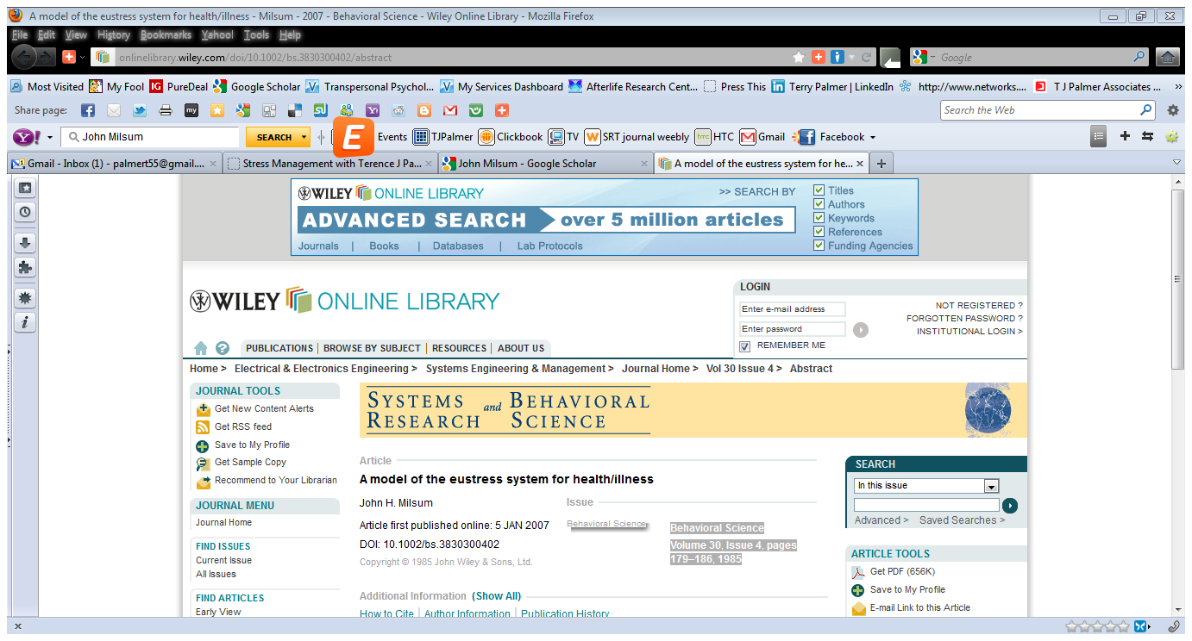

Slide 15
Taking control
Pre-Stimulus
PNS
Endocrine System
Cognitive Processing
Appropriate Response

Slide 16
Mindfulness

Slide 17
Stress reaction model

Slide 18
Responding vs Reacting

Slide 19
Psychoneuroimmunology
Otherwise known as:
PNI
Mind over matter
Mind over body
Mind cure
Healthy mind = healthy body
Mind as creator
Mind as healer
Mind as destroyer

Slide 20
The Interactive Relationship
Internal environment
Nervous system
Endocrine system
Immune system
Beliefs & world view
Cognitive processing
External environment
Natural enemies
External pressures
Family demands
Work demands
Health demands

Slide 21
What next?
Coffee break
Some serious mindfulness and PNI
Have a nice break – be back in 20 minutes

