Slide 1
Dissociation
Escape from trauma and a gateway to who knows what other worlds.
Dr Terence Palmer PhD

Slide 2
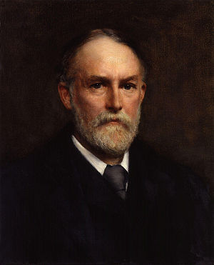
F.W.H. Myers
Deeper still lies the stage of highest interest – that sleep-waking in which the subliminal self is at last set free, is at last not only able to receive but to respond; when it begins to tell us the secrets of the sleeping phase of personality, beginning with directions as to the conduct of the trance or of the cure, and going on to who knows what insights into who knows what world afar? (Myers, 1903b, p. 133).

Slide 3
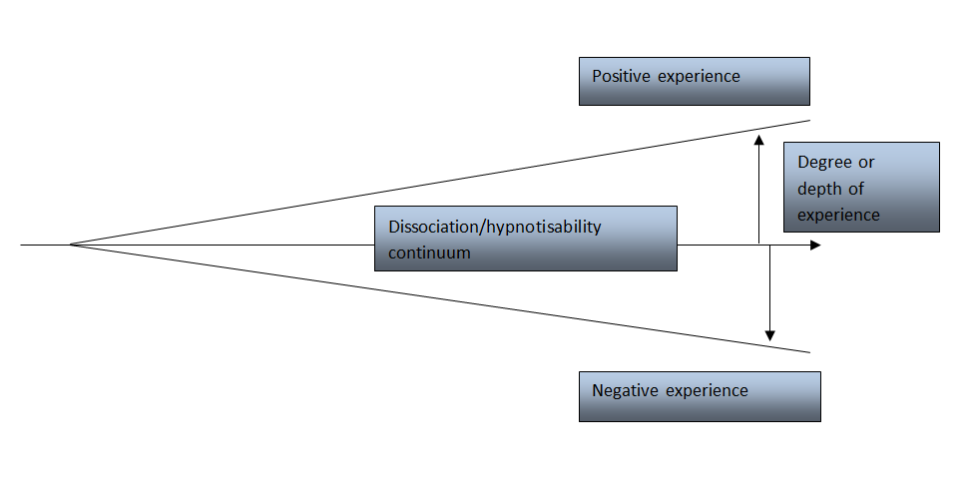
Vulnerability Model

Slide 4

A Study in dissociation – part 1

Slide 5
A study in dissociation – part 2

Slide 6
Protocol bullet points
Sovereignty – outer etheric body
Grounding
Inner etheric body
Chakras
Inter-dimensional parasites
Earthbound spirits
Self-created thought-forms
Dissociated sub-personalities
Causation – vulnerability

Slide 7

The future study of dissociation
Advances in the application of SRT are beyond common knowledge as I write, but the day will certainly arrive when these concepts will become more widely known and many mysteries that surround mental illness and criminal behaviour will be solved. I further anticipate that all medical students will be taught these facts during their training as medical professionals by accredited academic institutes. (p. 16).

Slide 8
Further information
https://www.terencepalmer.co.uk/dissociative-disorders/
Dissociation Chronological-table.pdf

