Slide 1
Remote spirit release
Adding value to medicine
Terence Palmer Phd

Slide 2
The ‘protocol’ efficacy test report
First efficacy test report of the remote spirit release protocol applied to 524 cases of suspected spirit possession

Slide 3
Overview of 524 recorded cases

Slide 4
524 recorded cases data snapshot

Slide 5
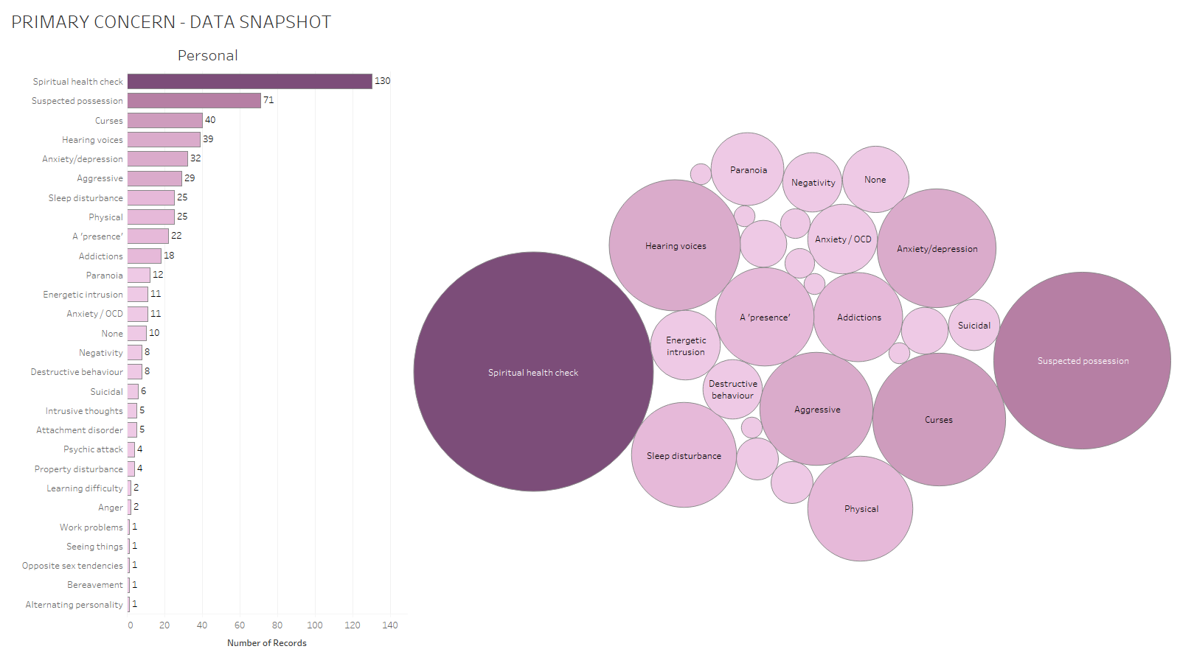

Slide 6
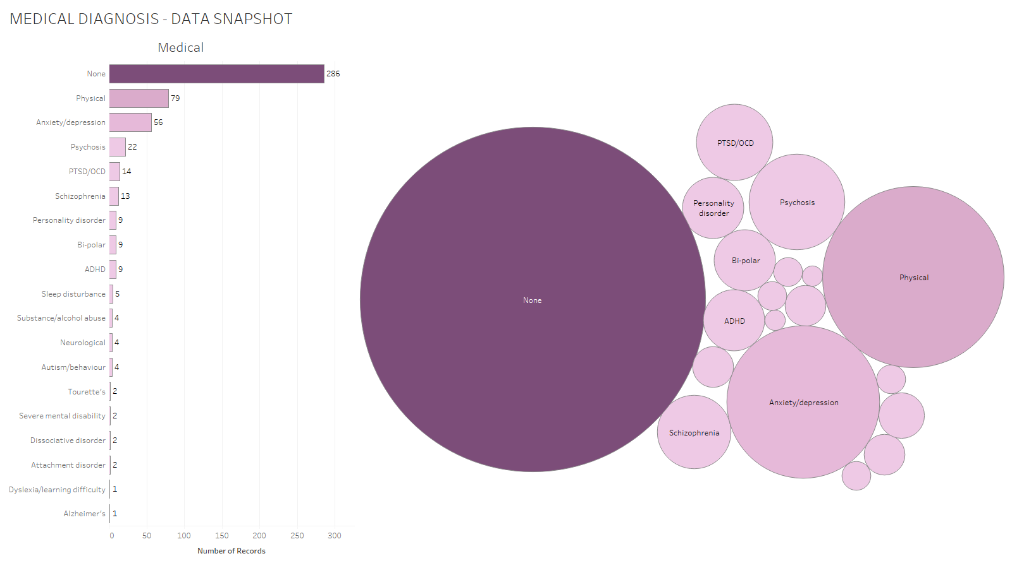

Slide 7
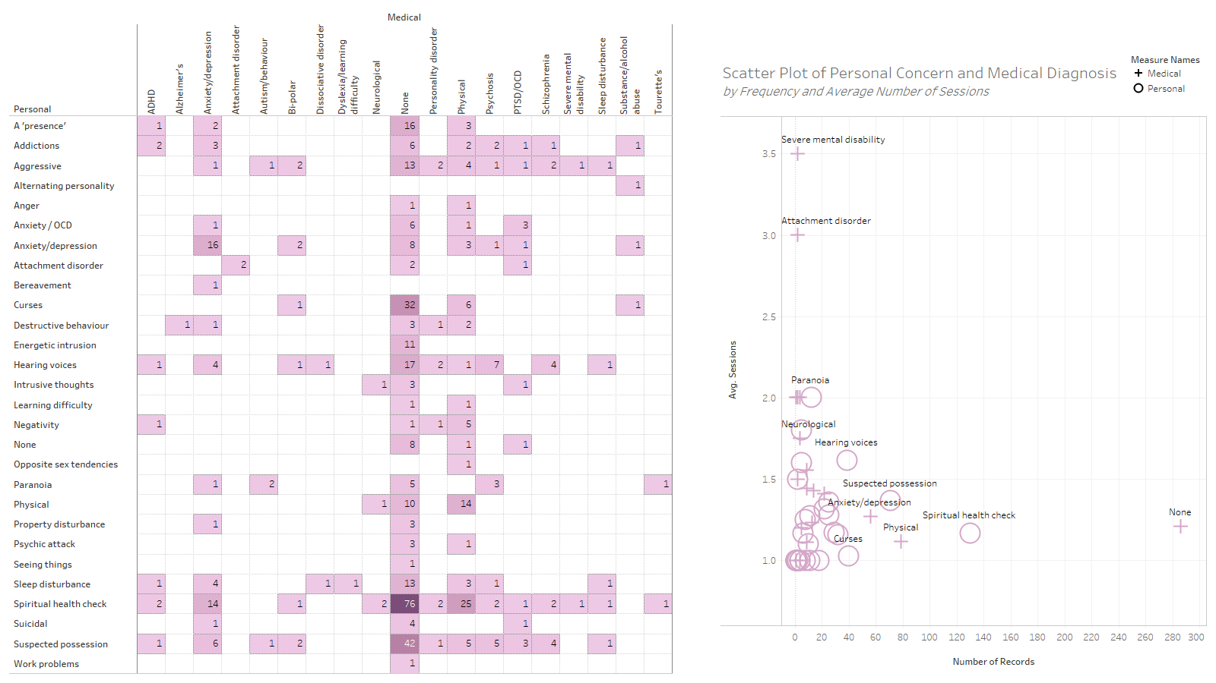

Slide 8
Reported findings
Sovereignty – Dark Force Entities (DFEs)
Grounding
Inner etheric
Chakras
Earthbound spirits attached
Self-created thought forms and dissociated sub-personalities
Primary cause

Slide 9
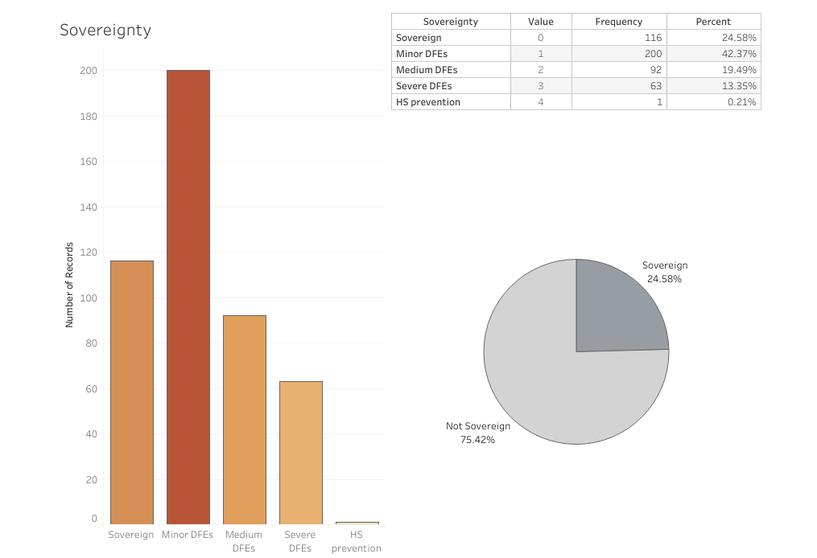

Slide 10
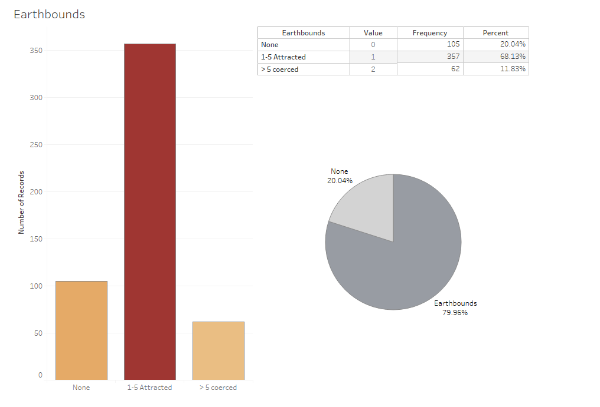

Slide 11
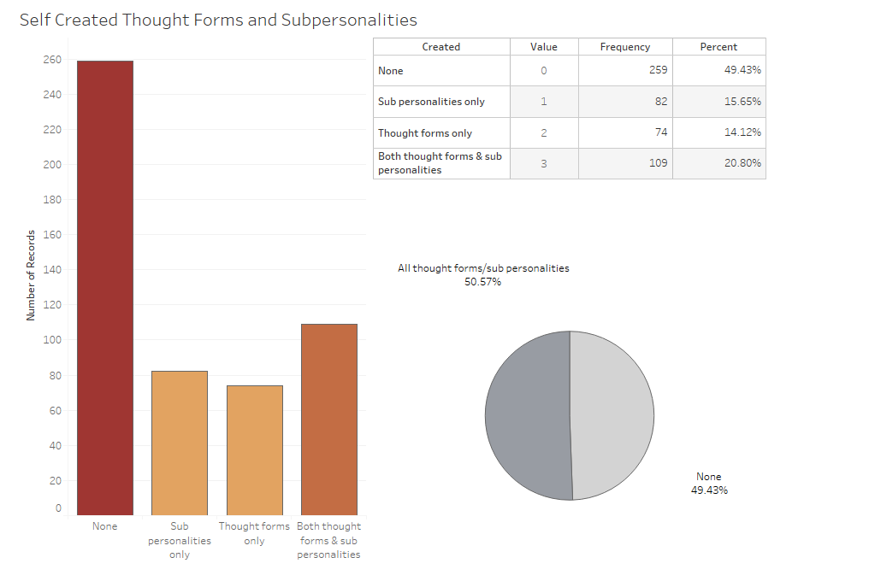

Slide 12
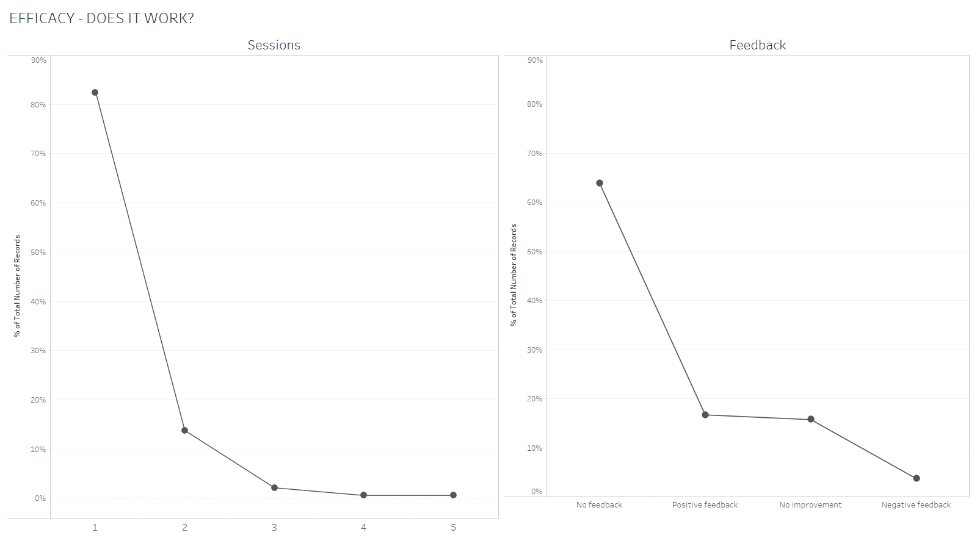

Slide 13
Efficacy – does it work?
Dear Dr Palmer.
But what really made me realise he is healing, is that for the first time in his life he told me he loves me. Can you imagine how valuable this is? He is able to express his love, his feelings and show affection.
It truly is a liberation.
It means so much to me, knowing you, Margaret and Andy have saved him, and also helped me to look beyond the problem, and seeing him whole again.
I will always be grateful for that. Thank you so much.
Warmest wishes,
(Anon)

Slide 14
A testimonial
I am pleased to report that I definitely feel a positive energetic shift, I’m increasingly feeling more aligned and as I write this I can actually feel joy flowing through me and I feel safe, I didn’t realise until now that I hadn’t felt this before. Reality feels very different and my energy feels minty fresh clean and I intend to keep it that way!!

Slide 15
Discourse analysis from recordings
Discourse between facilitator and medium
Between medium and spirit guides
Facilitator and spirit guides
Medium and spirit entities
Facilitator and earthbound spirits
Facilitator and remote patient

Slide 16
Share the knowledge with patrons
With researchers
With clinicians

Slide 17
Training – practical steps
Student fellowship patronage
Online observation in practice sessions
Eligibility evaluation
Group practical workshops on-site
Post-training online practice
Certificate of Professional Competence (CPC)

Slide 18
Constantly evolving to achieve best practice
Treatment
Research
Training

Slide 19
© 2019 Terence Palmer
https://www.terencepalmer.co.uk/
Data presentation by D. Lynch

